Slide 1


ANDHRA CHRISTIAN COLLEGE
GUNTUR
IIIrd B.Sc, VI Sem,
Topic:Fossil &Synthetic Fuels
By
Dr.M.RATNA RAJU
M.Sc[Tech], Ph.D, M.Th

Slide 2
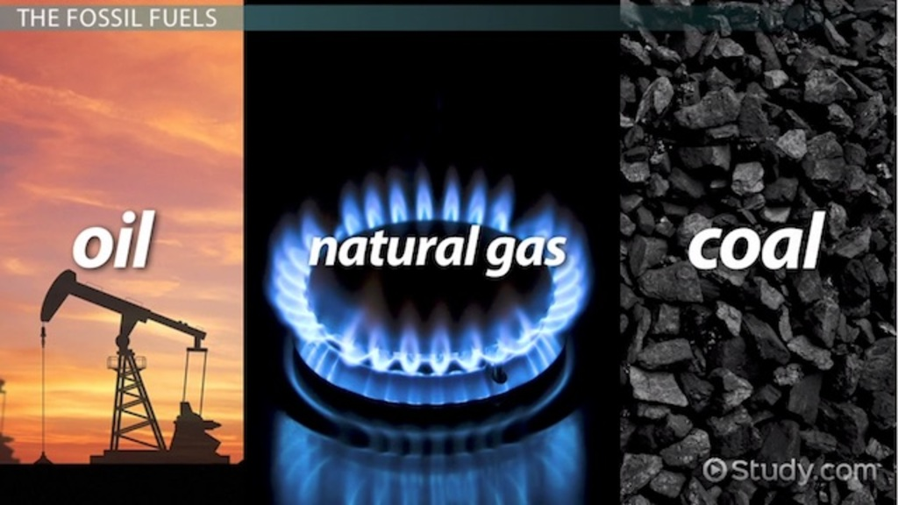
Fossil Fuel

Slide 3
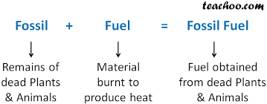
Fossil Fuel

Slide 4
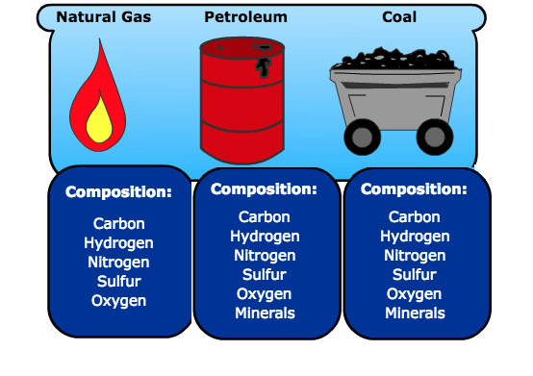
Fossil Fuel

Slide 5
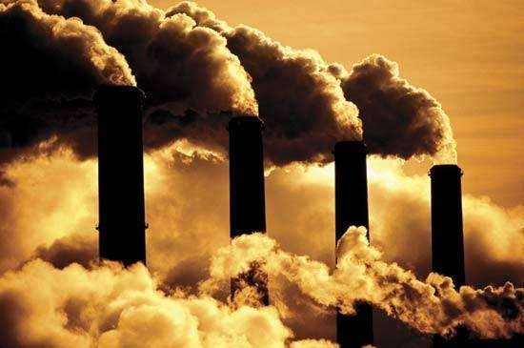
Fossil Fuel
Fossil Means: Remains of Dead animanl and
Plants obtained millions of years ago
Fuel Means: Material which is burnt to produce energy.
Fossil Fuel Means: Those fuels which are obtained from dead plants and animals millions of years ago.

Slide 6
Types of Fossil Fuel
There are three types of Fossil Fuels.
They are 1) Petroleum (Liquid), 2) Natural Gas (Gas), 3) Coal (Solid).
Fossil Fuels that comes from Petroleum are a) Gasoline) Jet Fuel, c) Kerosene, d) Diesel.

Slide 7
Advantages of Fossil Fuels
1) Easily mined and available for Consumption
2) Their molecular structure is extremely stable, i.e. they are not radioactive.
3) Most of the other fuels are derived from Fossil Fuels.

Slide 8
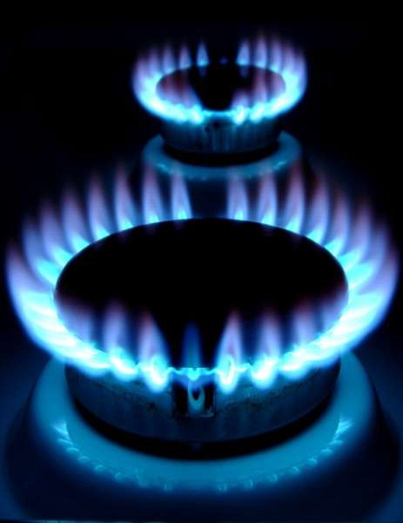

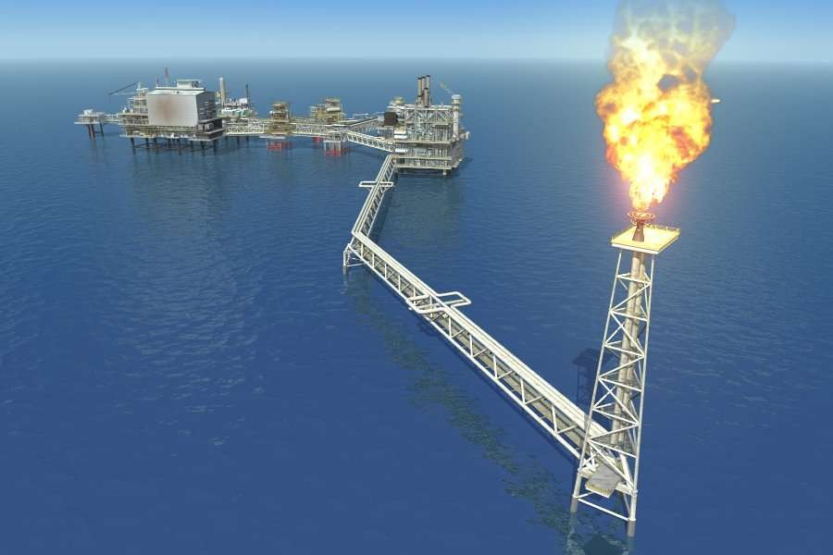
Disadvantages of Fossil Fuels
1) When Coal is burnt, carbon dioxide is produced, which causes global warming.
2) Non renewable
3) Because of the Pollution, Human Lungs are greatly effected.

Slide 9
Synthetic fuel
Synthetic fuel or synfuel is a liquid or gaseous fuel, obtained from a mixture of carbon monoxide and hydrogen.

Slide 10
Synthetic fuel
Any fuel, such as gasoline, diesel, or kerosene that is produced through the synthesis of hydrogen gas, is considered a synthetic fuel

Slide 11
Synthetic fuel
Synthetic fuel is a substitute for oil and natural gas manufactured from coal or from 'biological waste'.
The synthetic fuels are mainly used as fuels for combustion engines in the transport sector.

Slide 12
Synthetic fuels or Synfuels
Synthetic fuel is a category of fuels that includes any fuel "produced from coal, natural gas or biomass feedstock through chemical conversion
The synfuels category also includes fuels derived from synthetic crude, a substance similar to crude oil that is synthesized from natural resources like bitumen or oil shale

Slide 13
Advantages
The main advantage of synfuels is that they can be produced using substances like coal, natural gas and even plant waste, which are widely available.
Many synfuels also burn cleaner than conventional fuel.

Slide 14

Disadvantages
Synfuels still remain more expensive to produce than conventional fuels.
producing synthetic fuels often causes more, pollution than traditional gasoline.

